Slide 1
Capstone Design Presentation

Slide 2
Meet the Team
1
AN JISU
LEE HYUNJAE
JEON JINWOO
Jane Doe
Jane Doe
Jane Doe
BACKEND DEVELOPER
backend developer
FRONTEND DEVELOPER
Server management, Server-side development
Database, Server-side development
Highlight algorithm, Dashboard UI
ajs7270@gmail.com
leehj8687@email.com
zinuzian@gmail.com
Notes:
© Copyright Showeet.com – Creative & Free PowerPoint Templates

Slide 3
Contents
13th week’s progress
Schedule
Q&A

Slide 4
13th week’s progress
[Feedback] Face detection: Hyunjae
[Feedback] Threading and testing :Jisu
Payment function and UI revision : Jinwoo

Slide 5
[Feedback] Face detection
[Feedback] Face detection: Hyunjae

Slide 6
[Feedback] Face detection
[Previous model]
If the specific time to check is 10s, and fps of the video is 30
We Checked only #frame 299 (since it is 0-based index)
reference from this link
Notes:
지난번에 디자인했던 알고리즘
10초인경우

Slide 7
[Feedback] Face detection
[Possible issues]
If the specific frame doesn’t have any detected face,
We will ignore the specific time without checking other frames even though other frames might have detected faces.

Slide 8
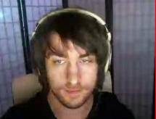
[Feedback] Face detection
[Possible issues example]
: If fps is 5, and
the specific time is 5 sec,
We checked only #frame 24
#24
5sec

Slide 9
[Feedback] Face detection
#20, #21, #22, #23, #24
[How to solve]
: We check whole frame,
and calculate
average emotional probabilities of them
5sec

Slide 10
[Feedback] Face detection
[Performance improvement]
More robust and accurate, but slower.
Since we now check frames ‘fps’ times more.
What about ‘slower rendering’?
→ we have mailing service

Slide 11
[Feedback] Face detection
[Performance improvement]
Before) we checked only 5 frames
Now) If fps is 30, then we check 30 * 5 = 150 frames
which means the probability of detecting faces is way higher.

Slide 12
13th week’s progress
2. [Feedback] Threading and testing :Jisu

Slide 13
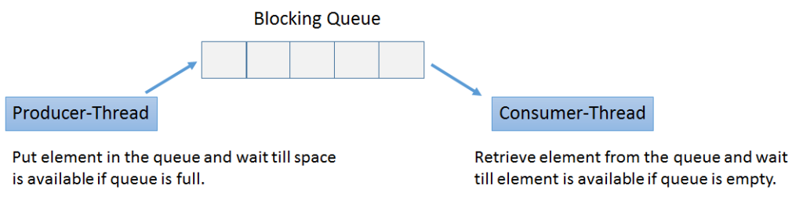
[Feedback] Threading and testing

Slide 14
[Feedback] Threading and testing
Django only
For testing
Apply webserver
For distribute

Slide 15
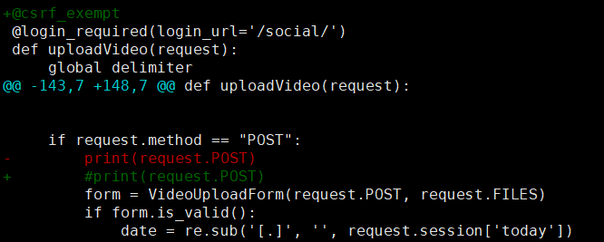
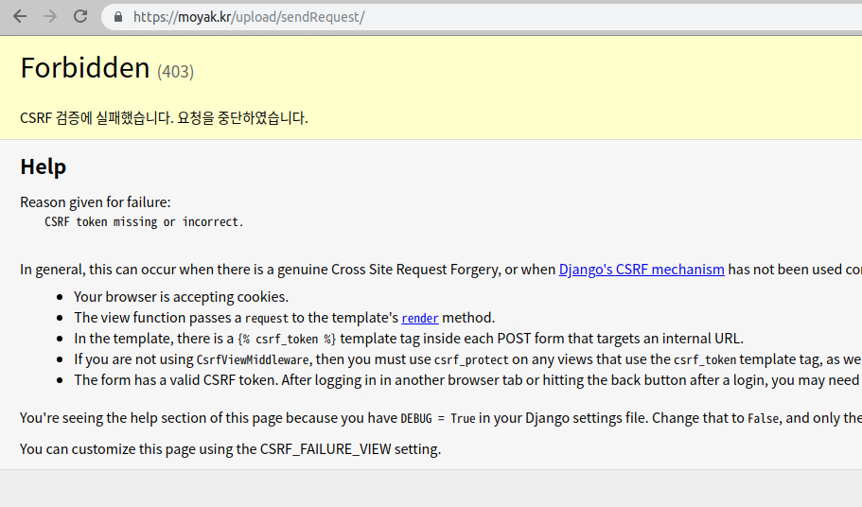
[Feedback] Threading and testing

Slide 16
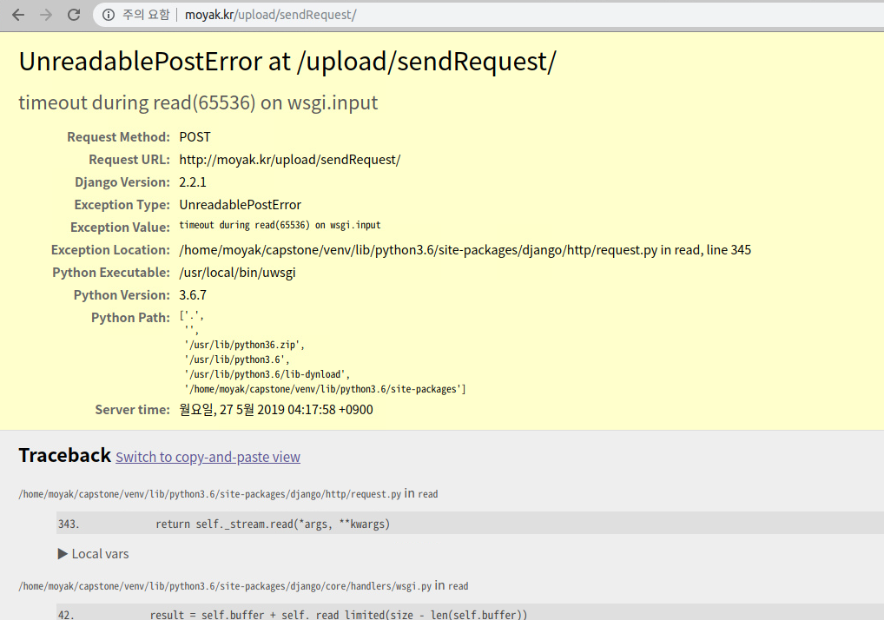
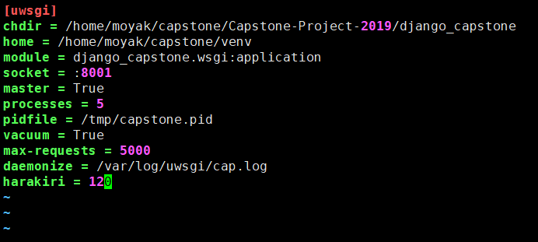
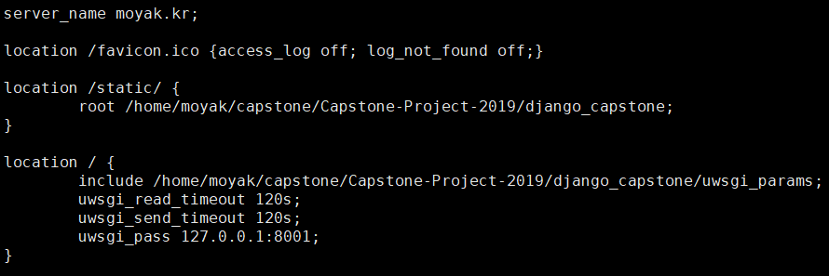
[Feedback] Threading and testing
[/etc/uwsgi/vassals/uwsgi.ini]
[/etc/nginx/sites-available/default]

Slide 17
13th week’s progress
3. Payment function and UI revision

Slide 18
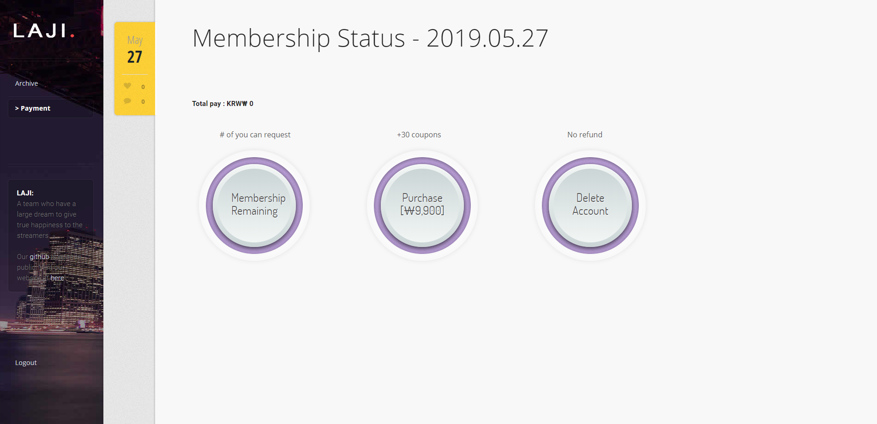
Payment function and UI revision
Payment UI

Slide 19
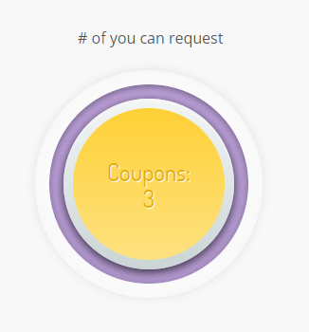
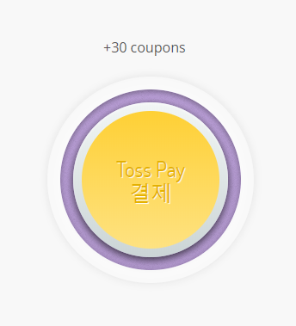
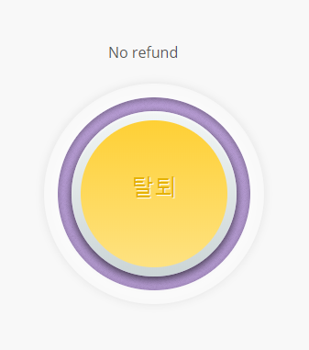
Payment function and UI revision
Mouse Hover

Slide 20
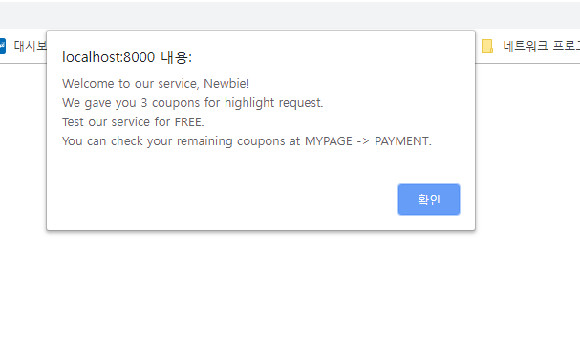
Payment function and UI revision
Coupons
3 Coupons for NEWBIE
Notes:
새로 가입한 회원에게는 3개의 쿠폰을 무료로 제공

Slide 21
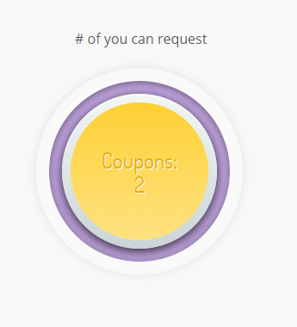
Payment function and UI revision
Coupons
request
No Negative Value
(Positive Integer Field)
Notes:
리퀘스트 보내고 나면 쿠폰 수 줄어듬
Positive integer field 적용으로 음수 불가

Slide 22
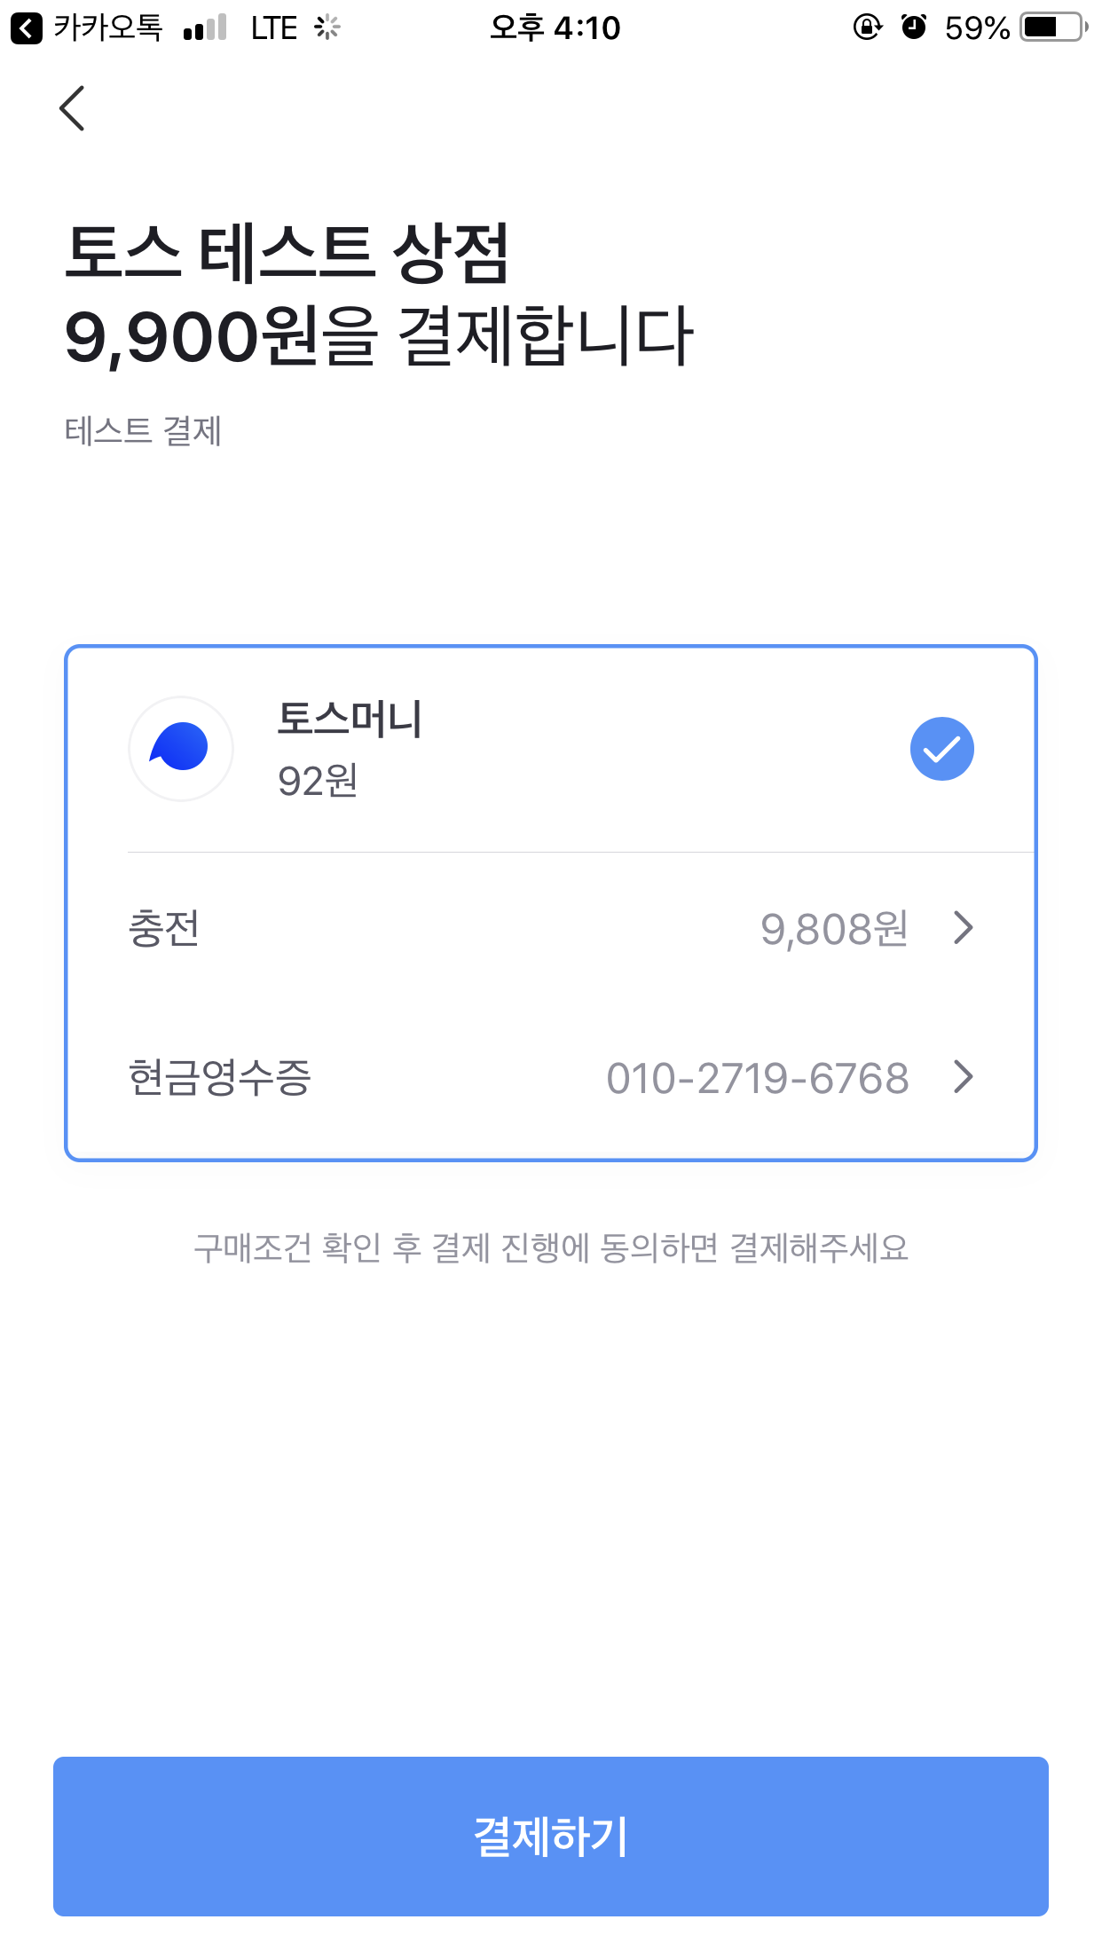
Payment function and UI revision
Purchase
click
Notes:
클릭하면 폰으로 알람, 정보입력, 결제

Slide 23
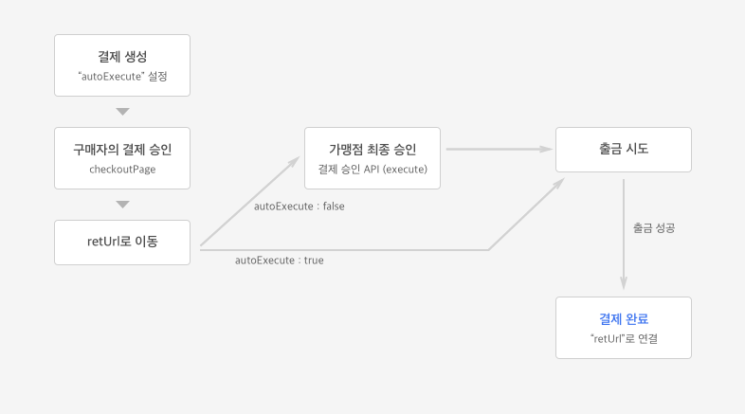
Payment function and UI revision
Purchase
Notes:
클릭하면 폰으로 알람, 정보입력, 결제

Slide 24
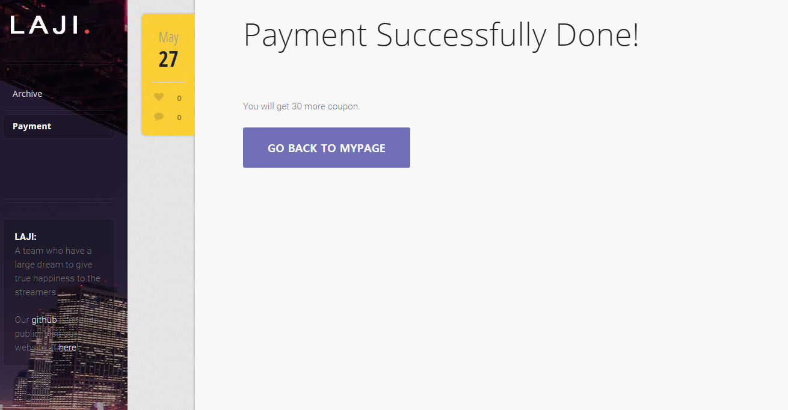
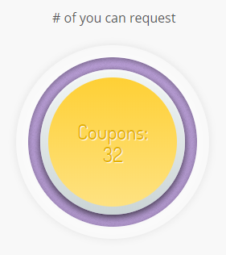
Payment function and UI revision
Purchase
+30
Notes:
30개 추가

Slide 25
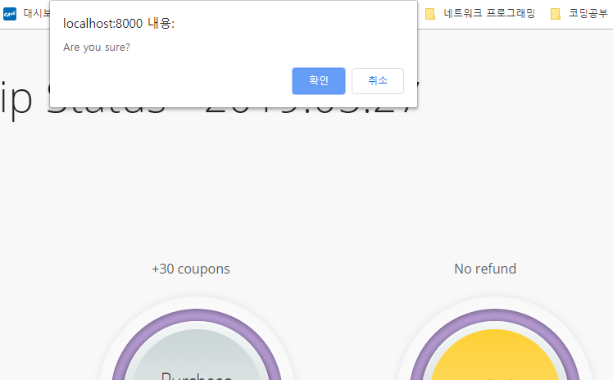
Payment function and UI revision
Delete Account
click
Notes:
탈퇴는 위험해서 꼭 물어봐야함

Slide 26
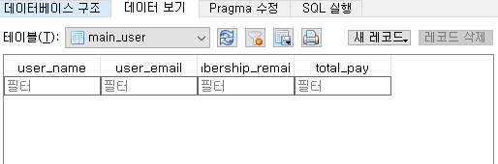
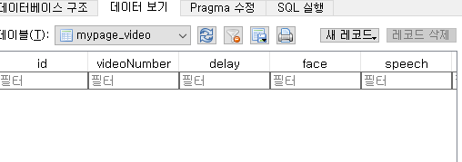
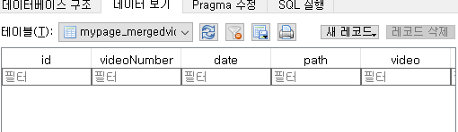
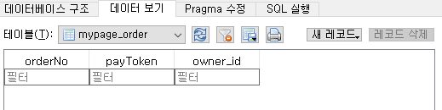
Payment function and UI revision
Delete Account
Notes:
CASCADE 적용으로 탈퇴한 유저와 관련된 DB 삭제

Slide 27
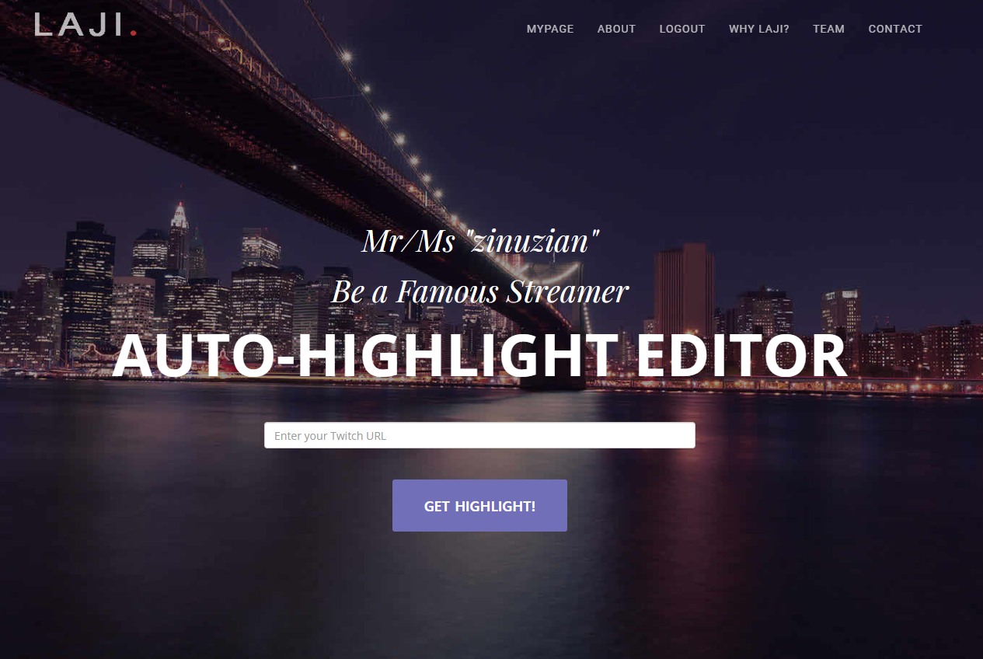
Payment function and UI revision
Index page
UI Revision
username
Notes:
유저 이름 표시하는 부분이 공백으로 뜨는 문제
뒤에가서 하이라이트 요청이나 payment, history 모두 문제 생김
로그인한 유저가 없는 상태

Slide 28

Payment function and UI revision
Index page
UI Revision
request.session.session_key?
Notes:
원인은 홈화면에서 세션키 여부를 확인해 다른 화면을 보여주는데
날짜를 세션에 저장하는 코드 때문에 로그인 정보가 없는데 일단 세션이 생성됨 -> 세션키 발급
날짜를 저장하는 코드 옮겨서 해결

Slide 29
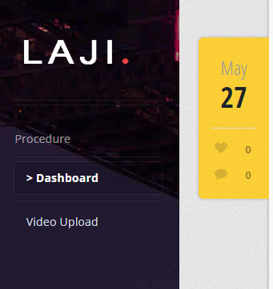
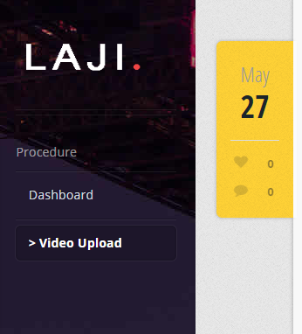
Payment function and UI revision
Upload UI Revision
Notes:
과정 더 잘 보이게 고침

Slide 30
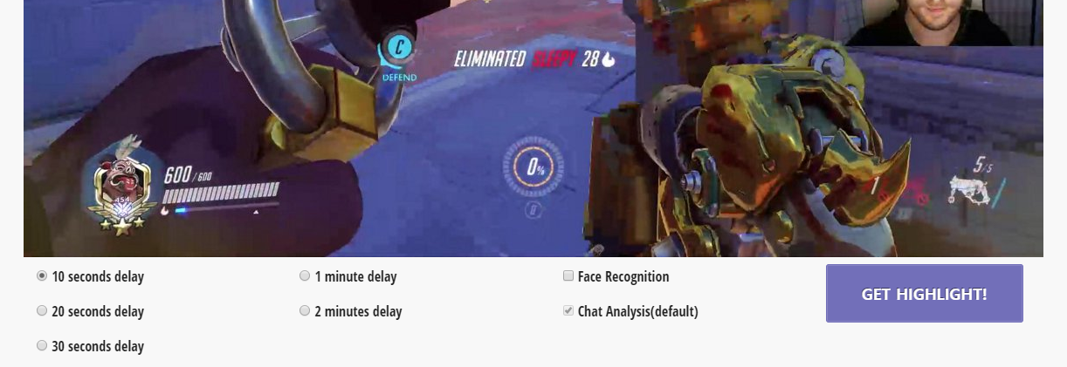
Payment function and UI revision
Upload UI Revision
Notes:
필요한 옵션들만 남기고 모두 삭제
채팅은 기본으로 분석하기 때문에 취소할 수 없게 함

Slide 31
Development plans
Week | Plan
2nd | Idea & Proposal
3rd | Idea & Proposal
4th | Server construction (Configuration setup : Nginx, domain(bind9), https), Test videos (Twitch/Game/Eng)
5th | Login (SNS), Database
6th | Video upload & download, Twitch chat API analyze
7th | Frame resizing, Web UI, Designing highlight algorithm
8th | Demo

Slide 32
Development plans
9th | Highlight video analyze algorithm development and test
10th | Highlight video analyze algorithm development and test
11st | Highlight video analyze algorithm development and test
12nd | Toss (payment), Notification mail, algorithm development, Server test
13rd | Preparing for Final demo , Queueing for threads
14th | Final demo
15th | Final report

Slide 33
Development plans
Jisu An,
Hyunjae Lee,
Jinwoo Jeon,

Slide 34
Thank you!

